Slide 1


Pilot-Efficient Channel Estimation for OFDM Systems
Prepared by: Assem Ahmad, Omar Morsi, Yazan Dewikat
Instructor: Dr. Jehad Hamamreh
Course: Data Communication and Networks
An-Najah National University

Slide 2
Project Overview
Abstract & Core Concept

Slide 3

INTRODUCTION TO OFDM
Industry Standard: Widely utilized in modern WiFi and 4G/5G systems.
Resilience: Efficiently handles multipath fading and inter-symbol interference.
Performance: Enables high data rates through parallel transmission.
Core Challenge: System reliability depends heavily on accurate Channel Estimation.

Slide 4

PROBLEM STATEMENT
Channel Distortion
The Efficiency Trade-off
Multipath fading and AWGN noise significantly distort the transmitted signal, leading to high error rates if not compensated.
Accurate estimation requires pilot subcarriers. However, more pilots mean more overhead and lower data throughput. We need efficiency.

Slide 5
PROJECT OBJECTIVES
Comparative Analysis: Evaluate LS and MMSE estimators in the frequency domain.
SNR Sensitivity: Analyze how noise levels affect estimation accuracy.
Efficiency Study: Investigate the impact of pilot spacing on spectral efficiency.
Quantifiable Metrics: Use Mean Square Error (MSE) and Bit Error Rate (BER) for validation.
Optimization: Identify ideal conditions for high-speed wireless recovery.

Slide 6


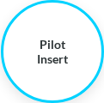
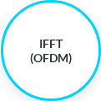


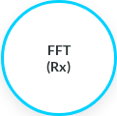
OFDM SYSTEM PROCESSING FLOW
Standard end-to-end signal processing chain for simulation.

Slide 7

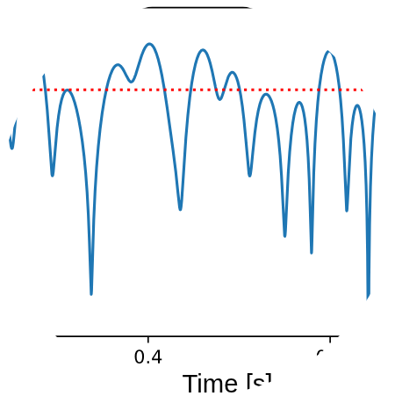
CHANNEL MODEL: RAYLEIGH FADING
Wireless Environment
Multipath Paths: Simulates signals bouncing off buildings and objects.
Statistical Model: Rayleigh fading represents non-line-of-sight communication.
Noise Addition: AWGN is added to model thermal noise at the receiver.

Slide 8
LEAST SQUARES (LS) ESTIMATOR
Characteristics
LOW
The LS estimator minimizes the squared distance between the received and the estimated signal.
Key Formula:
COMPLEXITY
Drawback: Highly sensitive to noise as it treats AWGN as part of the channel.

Slide 9
MMSE ESTIMATOR
Advanced Processing
MMSE utilizes channel statistics (Auto-correlation) to suppress noise effects during estimation.
HIGH
Optimization Goal: Minimizes the Mean Square Error between the actual and estimated channel coefficients.
ACCURACY
Benefit: Significant performance gain in low SNR environments.

Slide 10
COMPARATIVE MATRIX: LS VS MMSE
Feature | LS Estimator | MMSE Estimator
Complexity | Low (Simple division) | High (Matrix Inversion)
Accuracy | Baseline | Superior
Required Info | Pilot signals only | SNR & Channel Statistics
Noise Handling | Poor (Passes noise) | Excellent (Suppresses noise)

Slide 11
MATLAB IMPLEMENTATION
Simulation Parameters
Our study uses a robust MATLAB script to simulate the entire OFDM chain. Parameters included:
Modulation: QPSK
Number of Subcarriers: 64 to 256
Channel Type: Rayleigh (3-path)
Pilot Spacing: Configurable (1:4, 1:8, 1:16)

Slide 12


PERFORMANCE METRICS
MSE (Mean Square Error)
BER (Bit Error Rate)
Measures how close the estimated channel is to the true channel response.
The ultimate metric for communication reliability, measuring data bit errors after recovery.

Slide 13
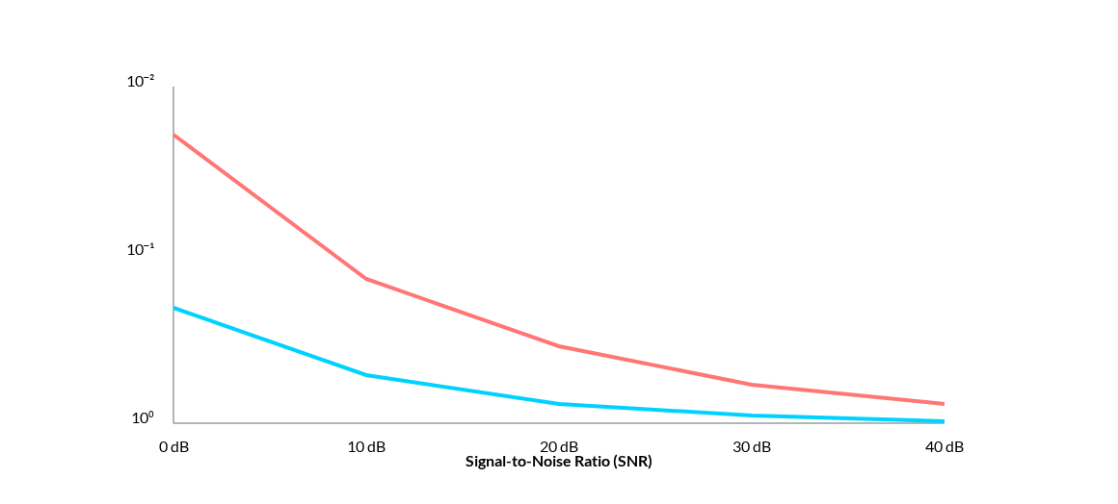
MSE PERFORMANCE ANALYSIS
● LS Estimator ● MMSE Estimator
* Logarithmic scale visualization of Error Reduction.

Slide 14
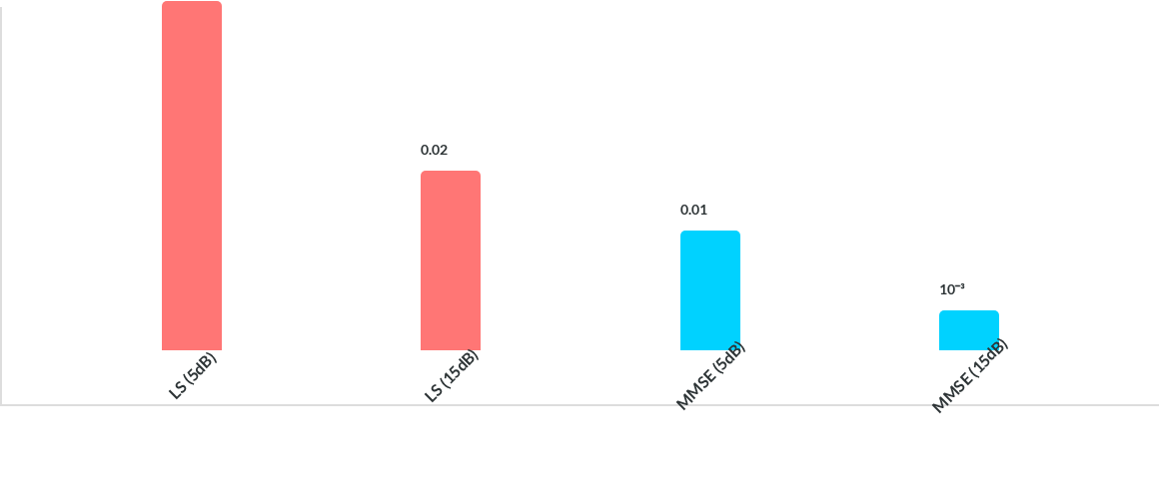
BER RESULTS VS SNR
MMSE provides several orders of magnitude improvement in data recovery.

Slide 15






IMPACT OF PILOT SPACING
Small Spacing
Large Spacing
The Sweet Spot
High estimation accuracy but reduced spectral efficiency due to overhead.
Increased data rates but higher risk of aliasing and interpolation errors.
Finding the balance where pilots are efficient enough to recover the channel within coherence bandwidth.

Slide 16
KEY OBSERVATIONS
40%
Noise Dominance: LS struggles significantly at high noise (low SNR).
Stability: MMSE is more stable across varying pilot densities.
MSE Reduction
MMSE vs LS at 10dB SNR
Efficiency: Pilot efficiency is maximized when the spacing matches channel coherence.

Slide 17

Conclusions
MMSE provides the necessary robustness for high-quality WiFi systems, while LS remains a viable candidate for low-power, simple IoT devices.

Slide 18

FUTURE RESEARCH DIRECTIONS
Adaptive Pilot Spacing: Changing pilot density based on real-time channel feedback.
Next Steps
AI & ML Estimation: Using neural networks for faster matrix computations in MMSE.
Our team plans to integrate 2D interpolation (Time-Frequency) to further improve tracking in highly mobile environments.
MIMO-OFDM: Extending estimation models to multi-antenna systems.

Slide 19

References & Final Word
Proakis, J. G. - Digital Communications, 5th Edition.
Goldsmith, A. - Wireless Communications, Cambridge University Press.
MATLAB Documentation - Signal Processing & Communications Toolboxes.
Thank you for your attention!
Assem, Omar, & Yazan | 2026

